Slide 1
Feedback Mechanisms

Slide 2
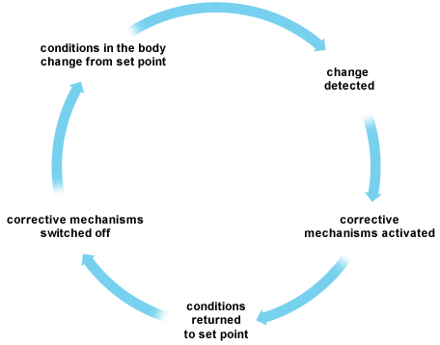
Homeostasis
One of the characteristics of living things is homeostasis
  Homeostasis is the maintenance of a stable internal state regardless of a changing external environment
  This stable internal state is usually not entirely rigid, but can fluctuate within a certain range
    This idea is called dynamic equilibrium
      Ex. We eat food and excrete waste every day, but our body weight stays relatively stable (usually within a few pounds).
The way organisms maintain homeostasis is through feedback mechanisms
  Typically, there are mechanisms that lower a condition when it is too high, and other mechanisms that raise the level when it is too low.
    Together, the system is called a feedback loop
      A feedback loop is any mechanism in which a condition triggers some action that causes a change in that same condition

Slide 3
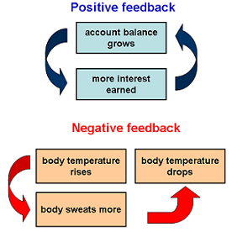
Feedback Mechanisms
Feedback mechanisms play an important role in a number of biological areas. There are two types of feedback.
Negative feedback keeps things stable and is usually beneficial in natural systems
Positive feedback loops can push systems further to the extremes and are often detrimental to natural systems

Slide 4
A Negative Feedback Example - Body Temp
Response
Temp Increases
Body Sweats
Temp Increases
Condition
Body Temperature (~98.6)
Temp Decreases
Body Shivers
Response
Temp Decreases

Slide 5

A Positive Feedback Example - Birthing Contractions
Condition
Oxytocin Stimulates Uterine Contractions and Pushes Baby Further Towards Cervix
Oxytocin Carried in Bloodstream to Uterus
Babies Head Pushes on Cervix
Brain Stimulates Pituitary Gland to Secrete Oxytocin
Nerve Impulses from Cervix Transmitted to Brain

Slide 6
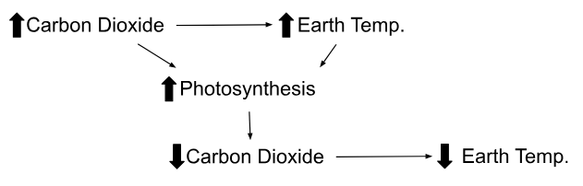
As carbon dioxide levels in the atmosphere rise:
• temperature of Earth rises. As Earth warms:
• the rate of photosynthesis in plants increases (both carbon dioxide and temperature are limiting factors for photosynthesis)
• more carbon dioxide is therefore removed from the atmosphere by plants, reducing the greenhouse effect and reducing global temperatures
Positive or Negative? NEGATIVE

Slide 7
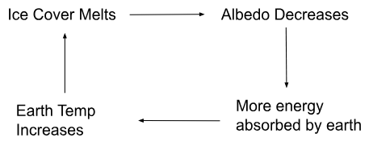
1. As Earth warms:
• Ice cover melts, exposing soil or water
• Albedo decreases (Albedo is a measure of how well a surface reflects solar energy)
• More energy is absorbed by Earth’s surface
• Global temperature rises
• More ice melts
Positive or Negative? POSITIVE

Slide 8
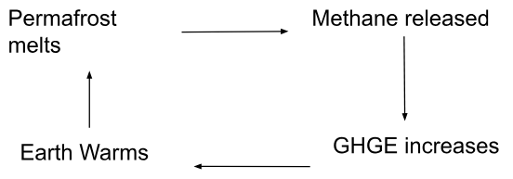
2. As Earth warms, upper layers of permafrost (frozen soil) melt:
• Methane gas is released in areas where there is no oxygen
• Greenhouse effect is enhanced
• Earth warms, melting more permafrost
Positive or Negative? POSITIVE

Slide 9
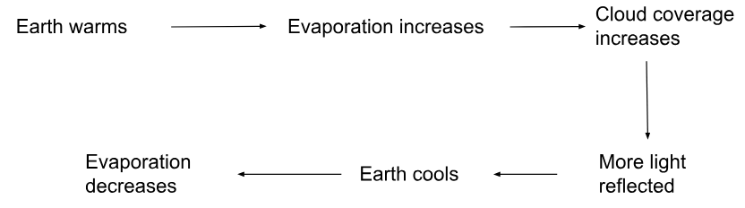
3. As Earth warms, increased evaporation:
• Produces more clouds
• Clouds increase albedo, reflecting more light away from Earth
• Temperature falls
• Rates of evaporation fall
Positive or Negative? NEGATIVE

Slide 10
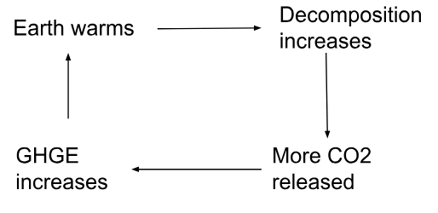
4. As Earth warms, organic matter in soil is decomposed faster:
• More carbon dioxide is released
• Enhanced greenhouse effect occurs
• Earth warms further
• Higher temperatures cause rate of decomposition to increase
Positive or Negative? POSITIVE

